Slide 1
HEO Concentration Tuning

Slide 2
Final Results – Use F = 0.0004
Increasing Ni concentration (Ni₀.₃, Zn₀.₁) results in higher thermal conductivity (2.655 W/mK). This is likely due to the reduced lattice distortion and phonon scattering when fewer Zn atoms are present, as Zn’s larger atomic radius introduces more disorder in the lattice.
Increasing Zn concentration (Ni₀.₁, Zn₀.₃) leads to a decrease in thermal conductivity (2.580 W/mK). The greater presence of Zn atoms causes more lattice distortion, phonon scattering, and mismatch, reducing the overall thermal conductivity.
The J14 model (Ni₀.₂, Zn₀.₂) demonstrates an intermediate thermal conductivity (2.634 W/mK), consistent with a balanced atomic composition.

Slide 3
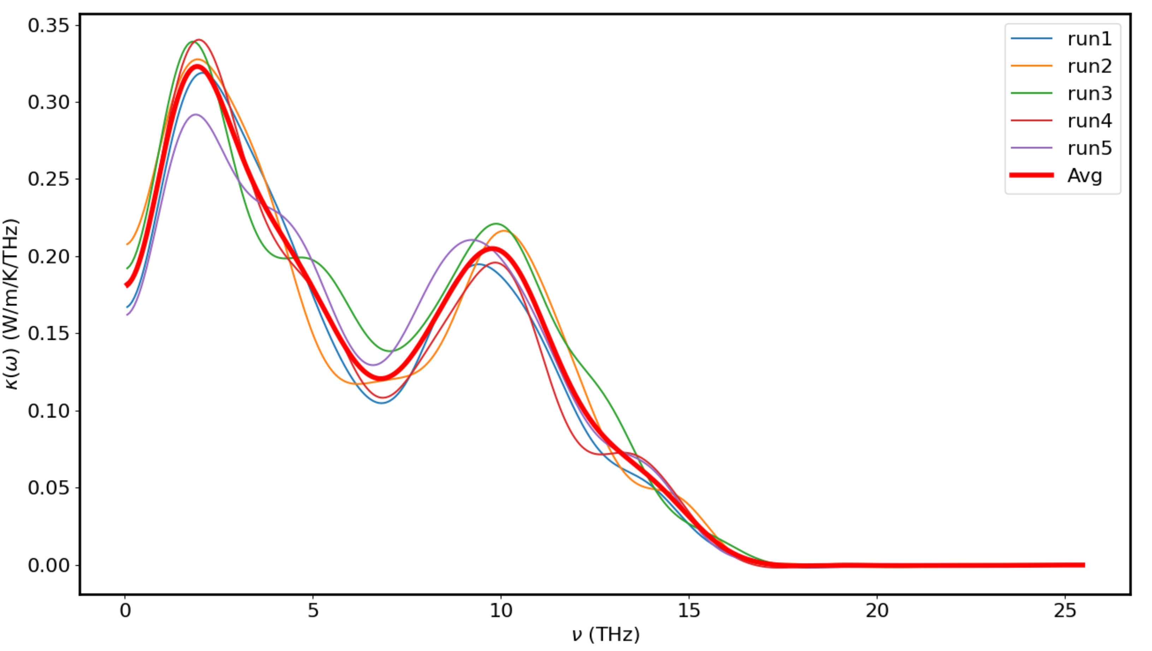
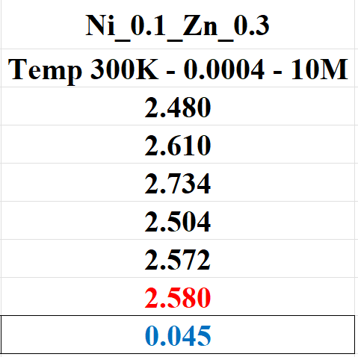
Ni_0.1_Zn_0.3 (400Ni - 1200Zn) - 300K – 0.0004 – 10M Runs

Slide 4
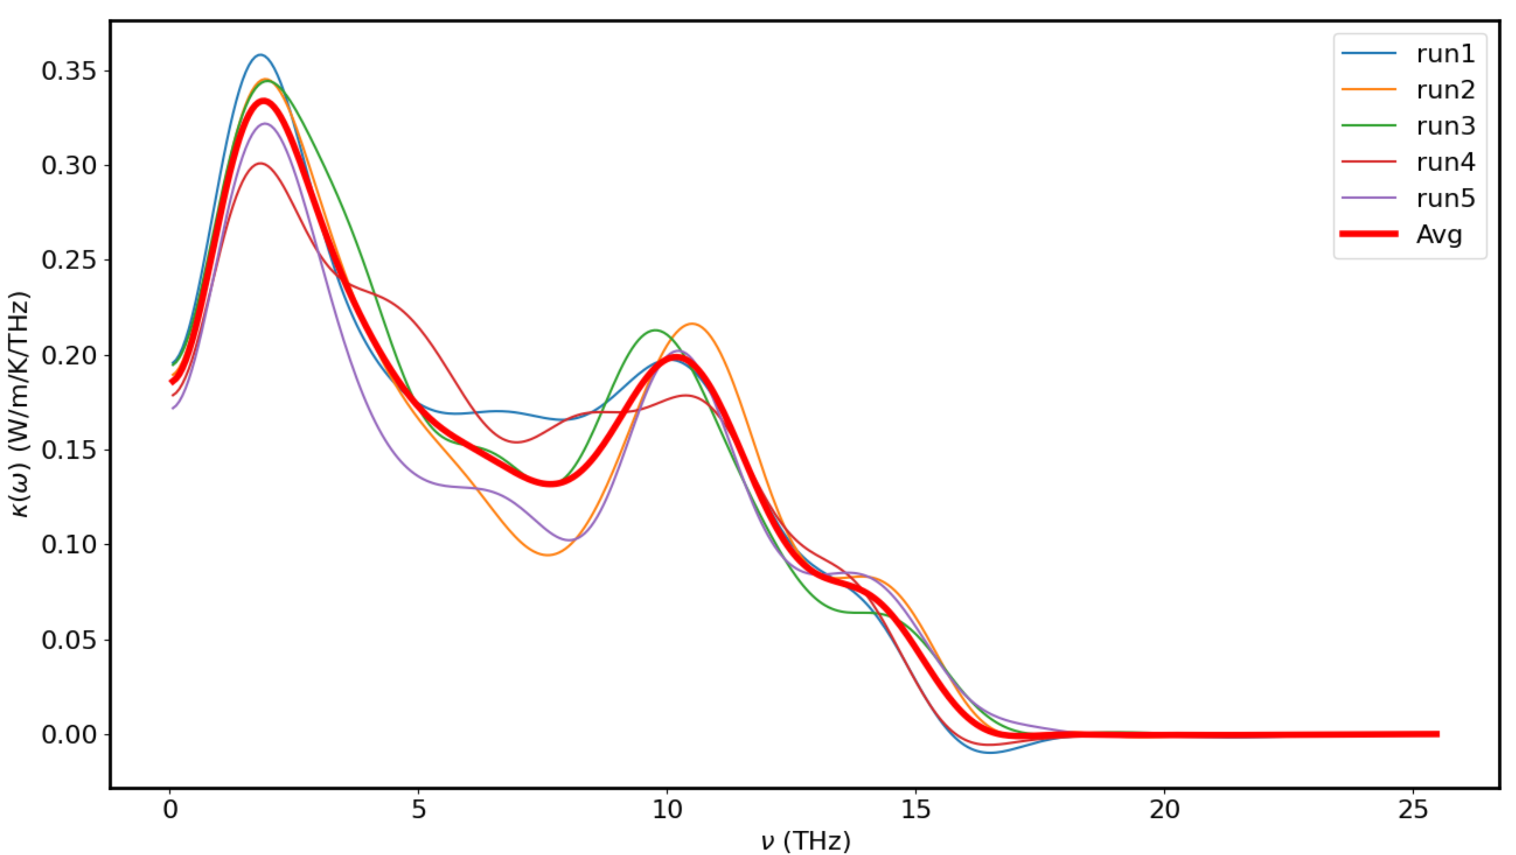
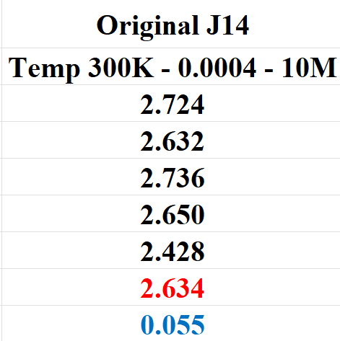
HEO – Original – 300K – 0.0004

Slide 5
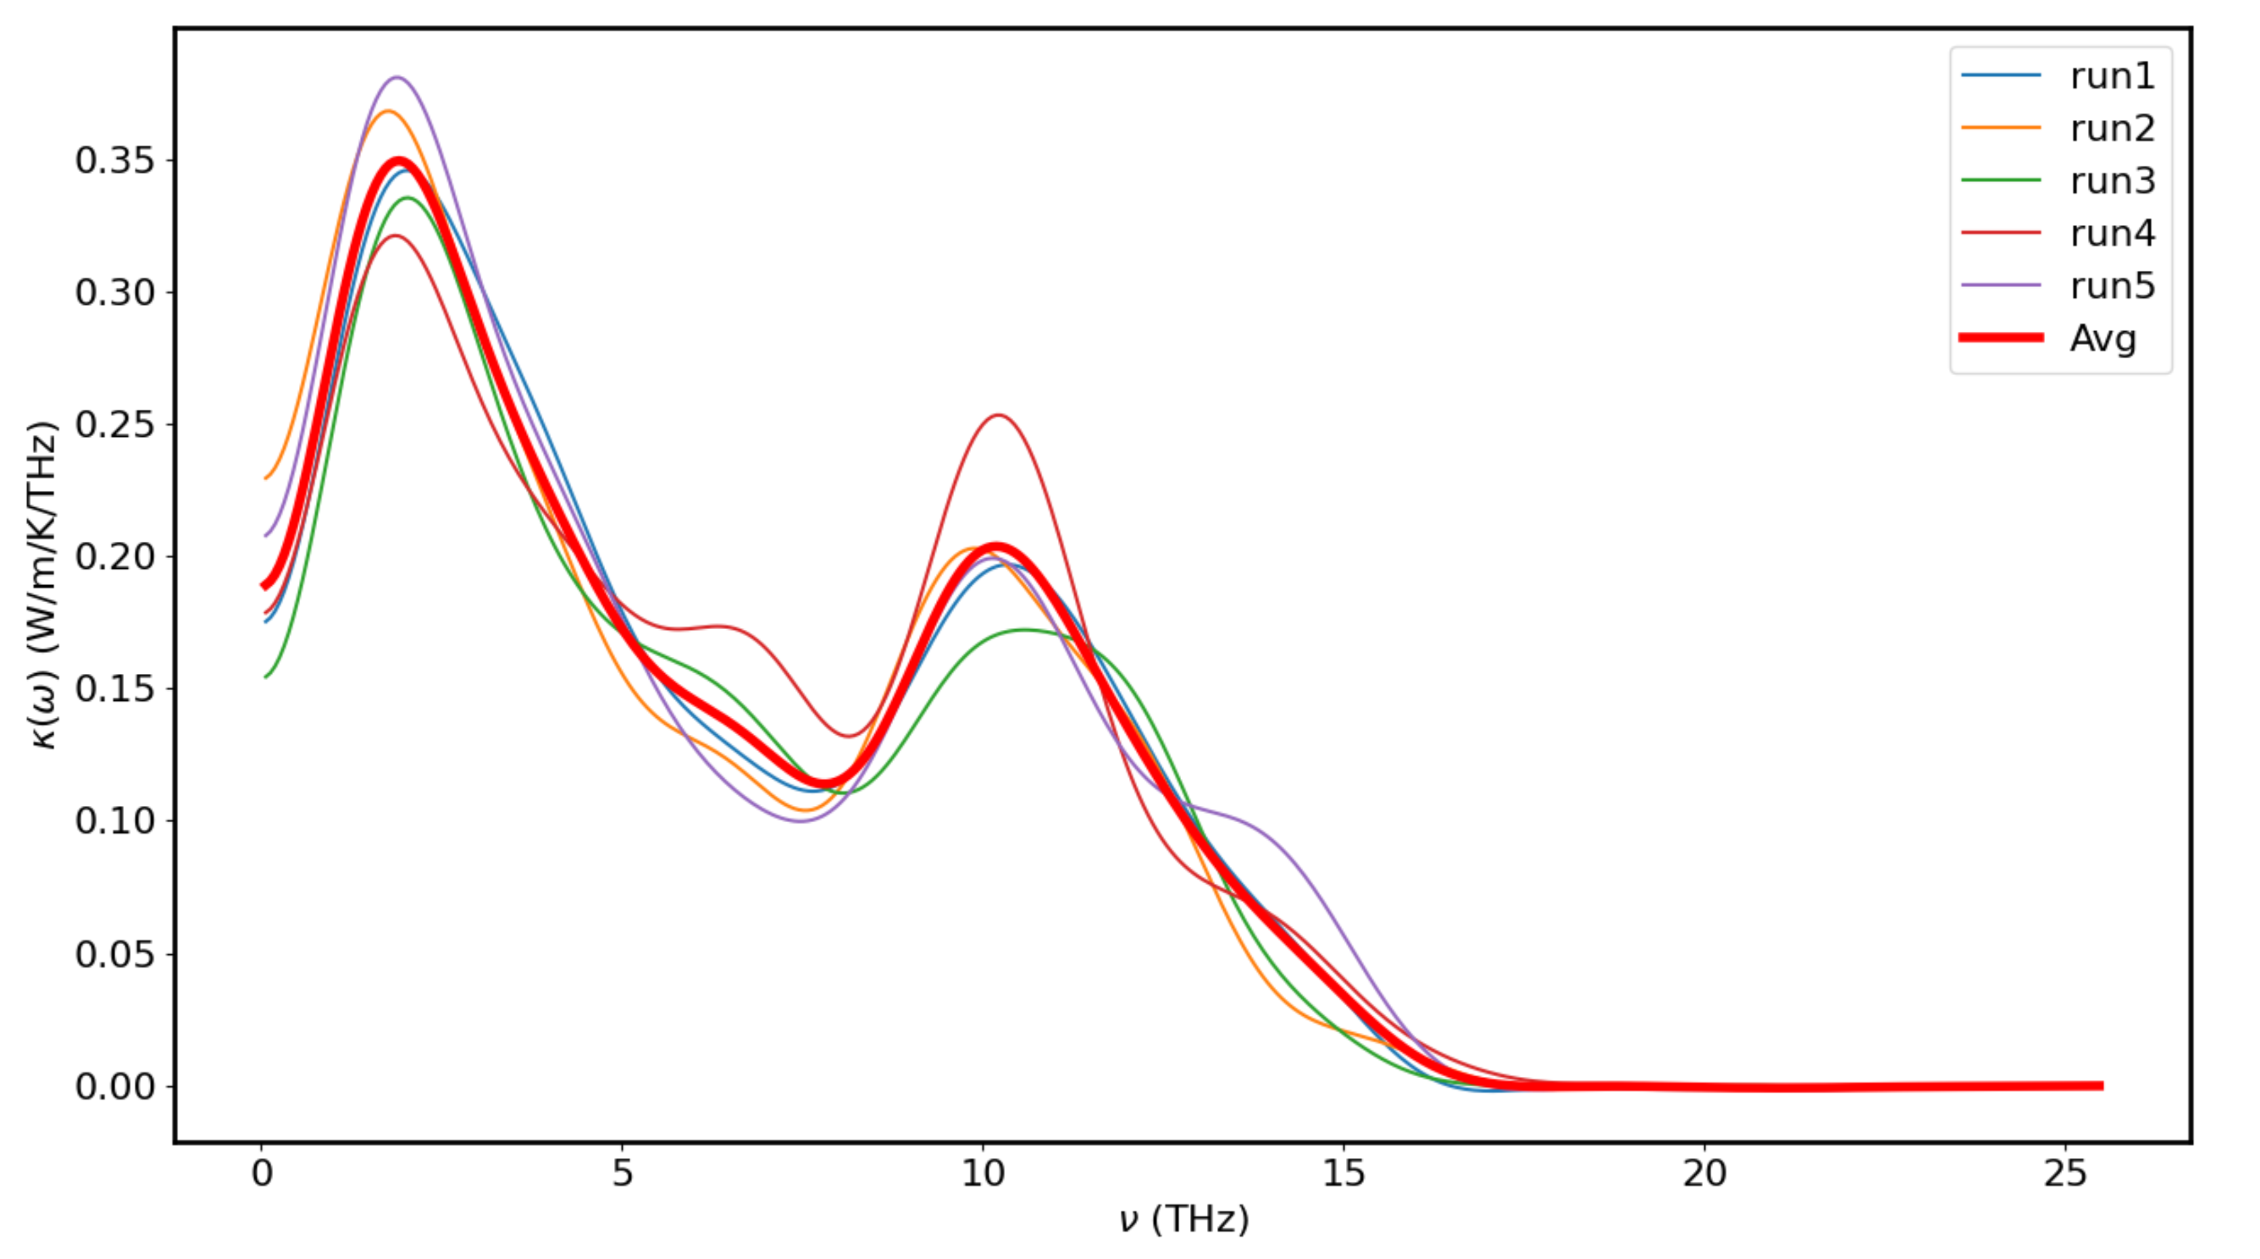
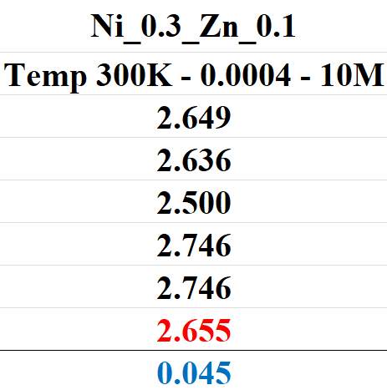
Ni_0.3_Zn_0.1 (1200Ni - 400Zn) - 300K – 0.0004 – 10M Runs

Slide 6
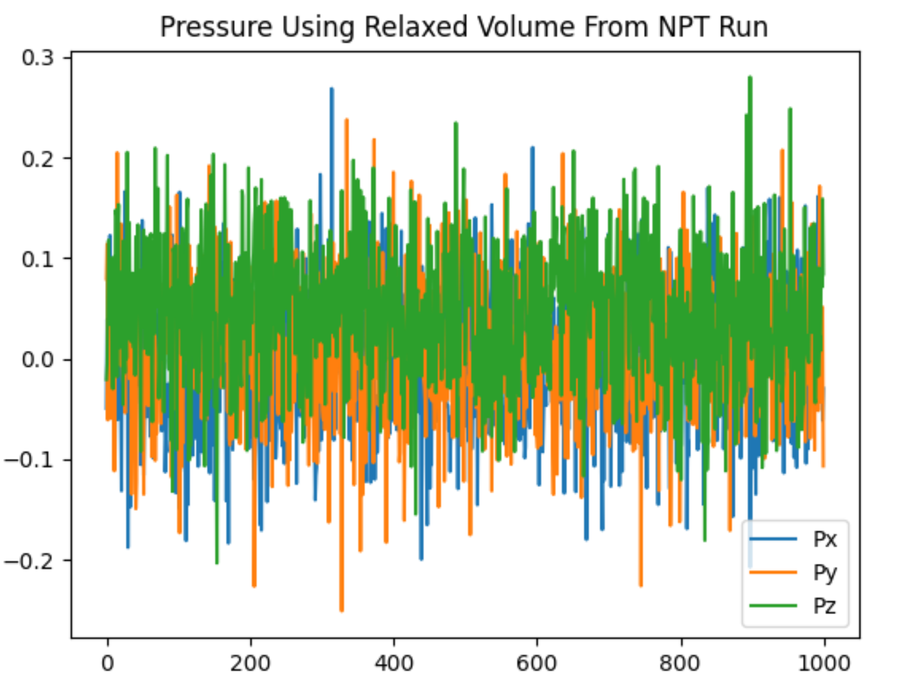
Ensure that Pressure = 0s

Slide 7
Additional Data for Experimental Runss

Slide 8
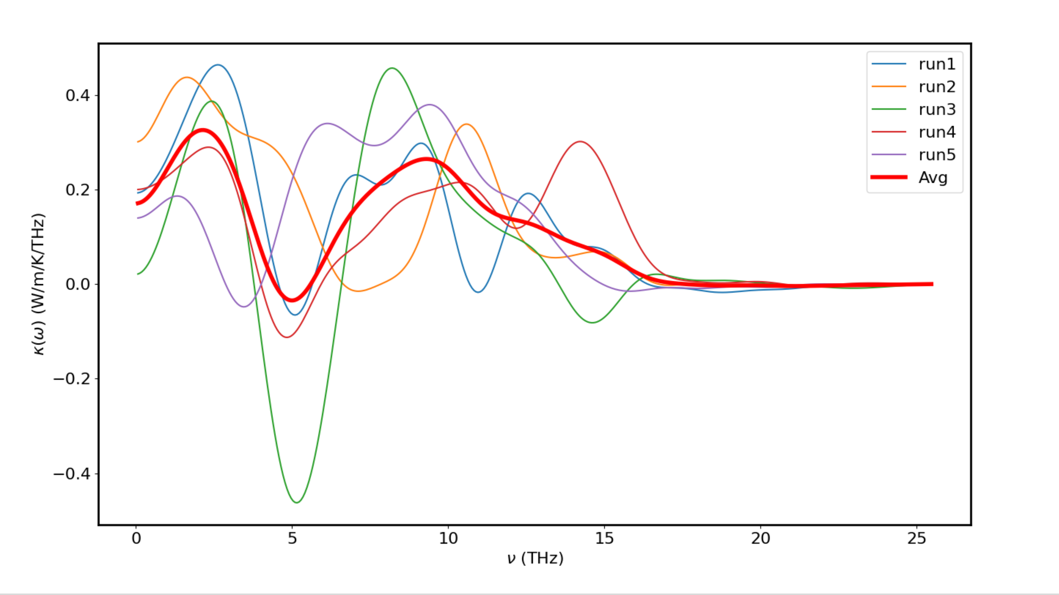
Ni_0.1_Zn_0.3 (400Ni - 1200Zn) - 300K – 0.00018

Slide 9
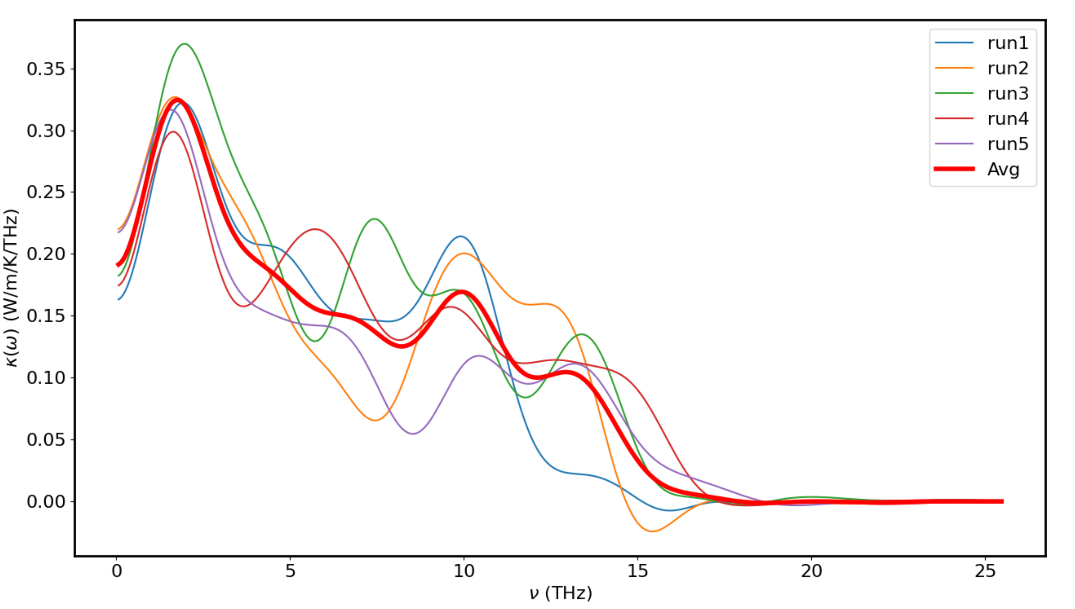
Ni_0.1_Zn_0.3 – 300K – 0.00018 – 10M

Slide 10
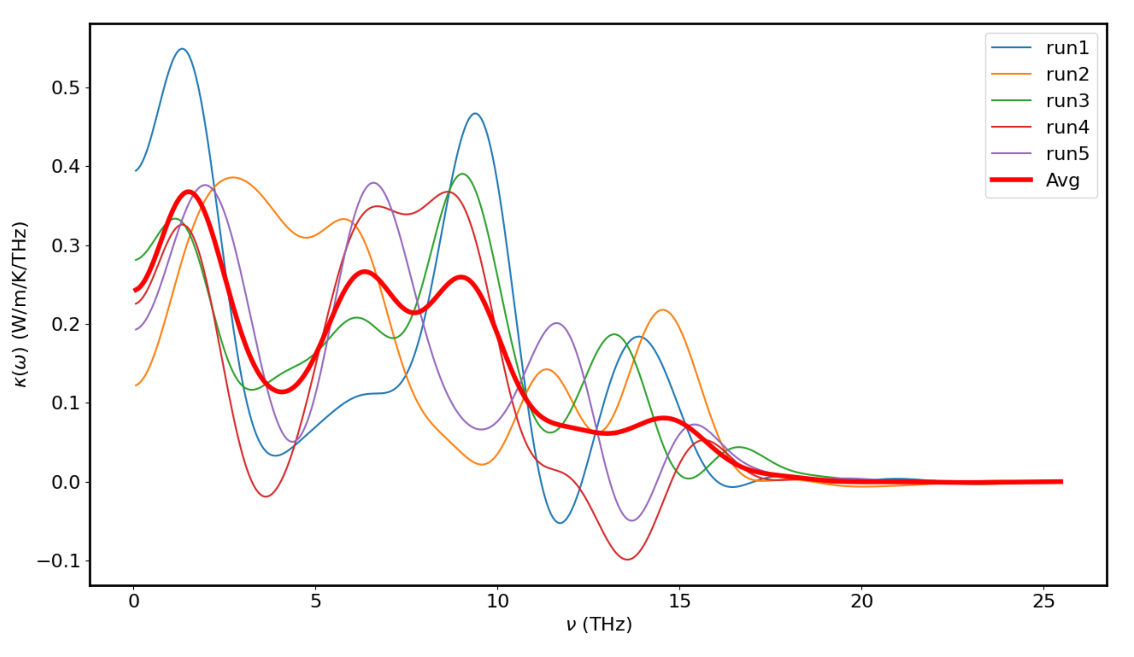
Ni_0.1_Zn_0.3 (400Ni - 1200Zn) - 300K – 0.00024

Slide 11
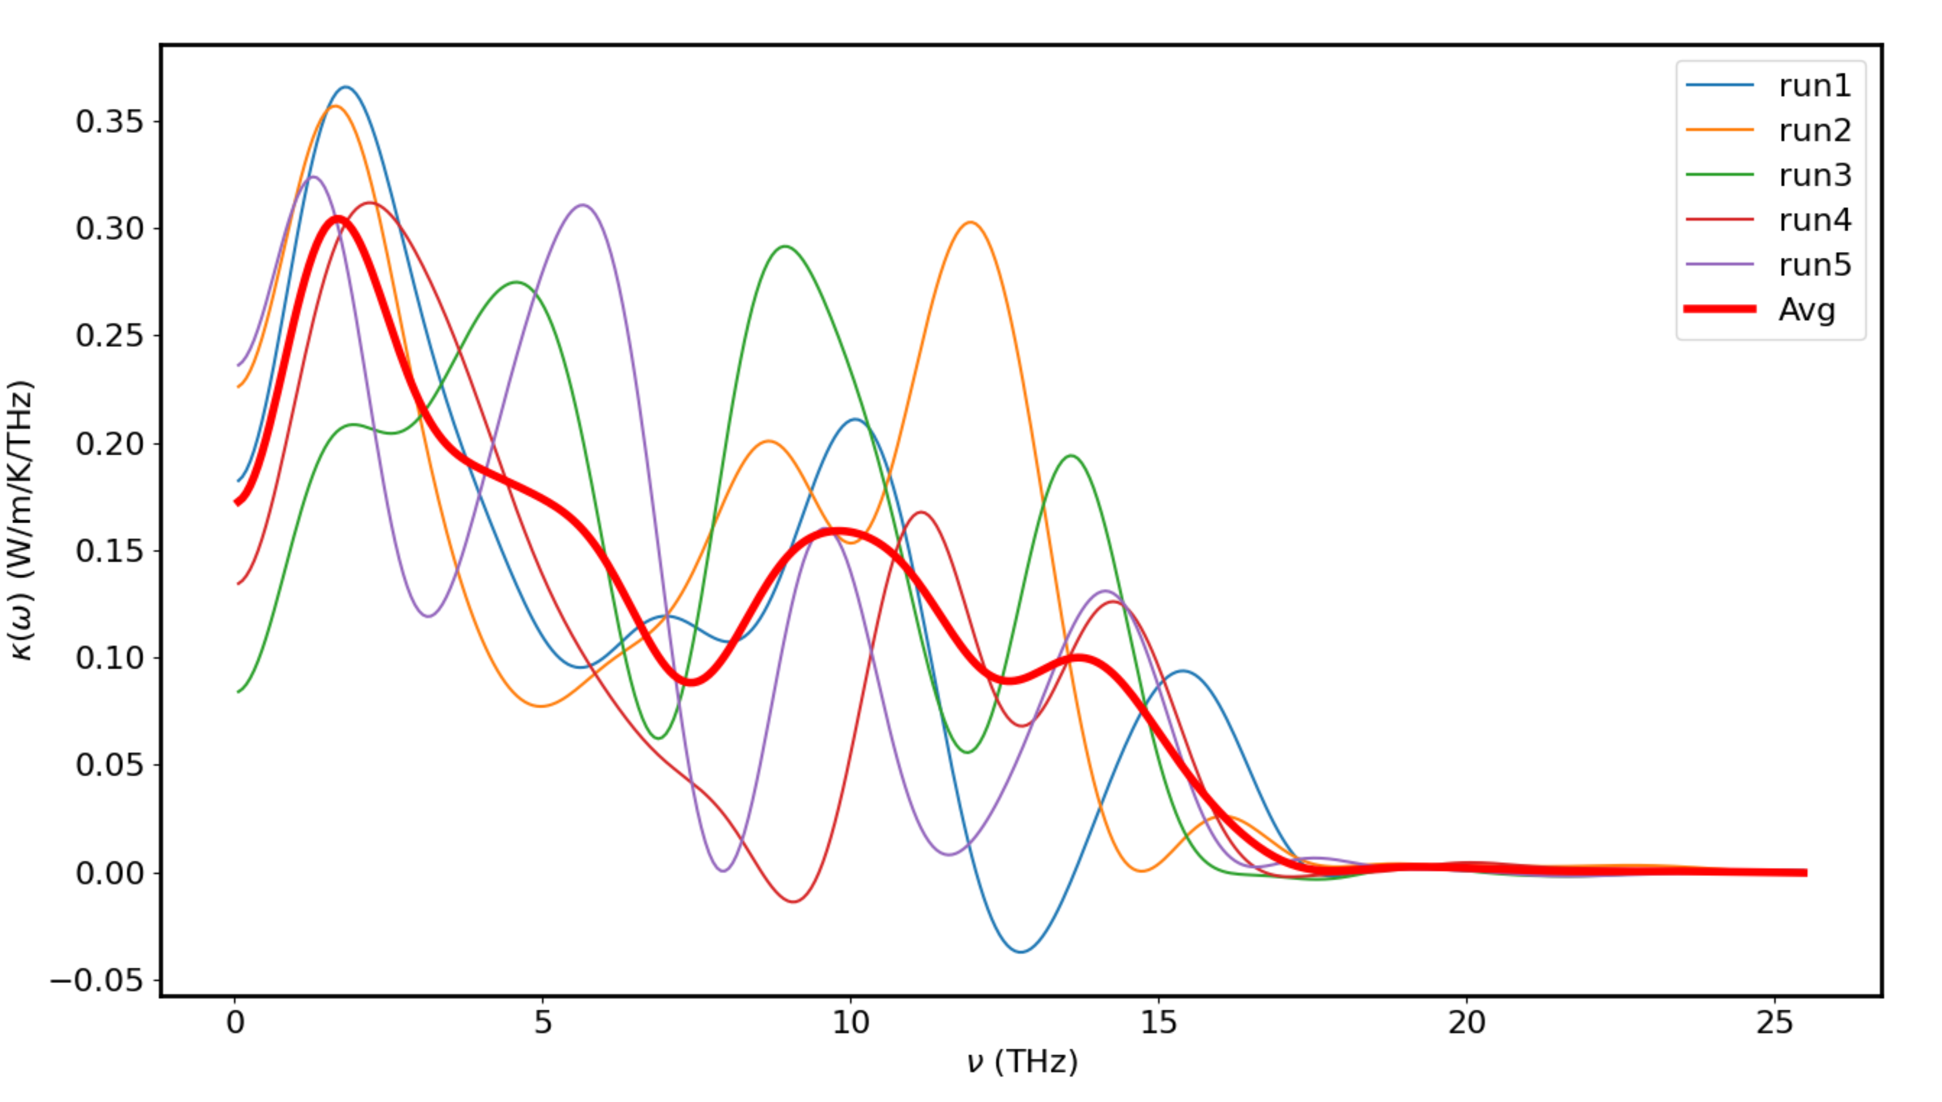
Ni_0.1_Zn_0.3 (400Ni - 1200Zn) - 300K – 0.0003

Slide 12
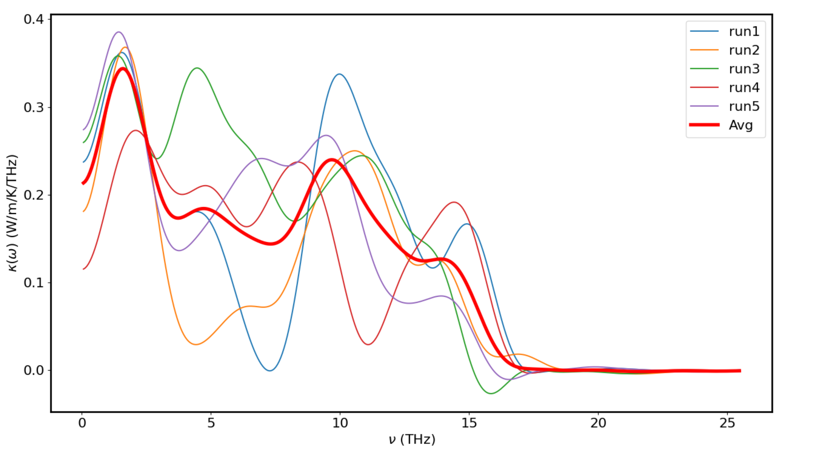
Ni_0.1_Zn_0.3 (400Ni - 1200Zn) - 300K – 0.00035

Slide 13
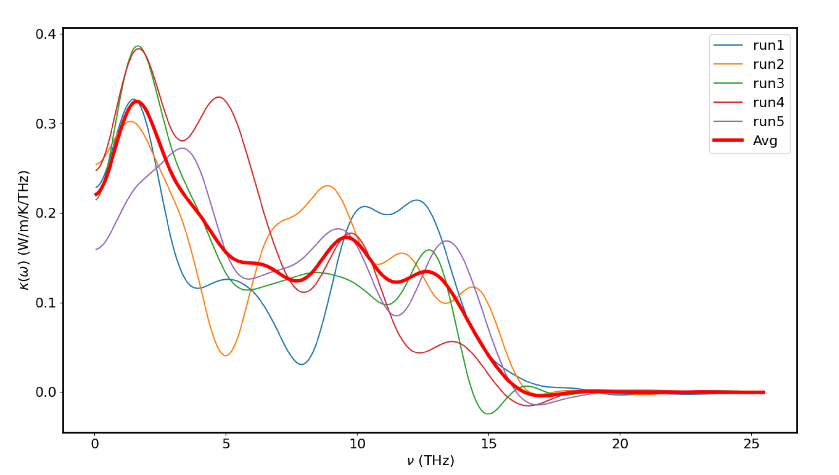
Ni_0.1_Zn_0.3 (400Ni - 1200Zn) - 300K – 0.0004

Slide 14
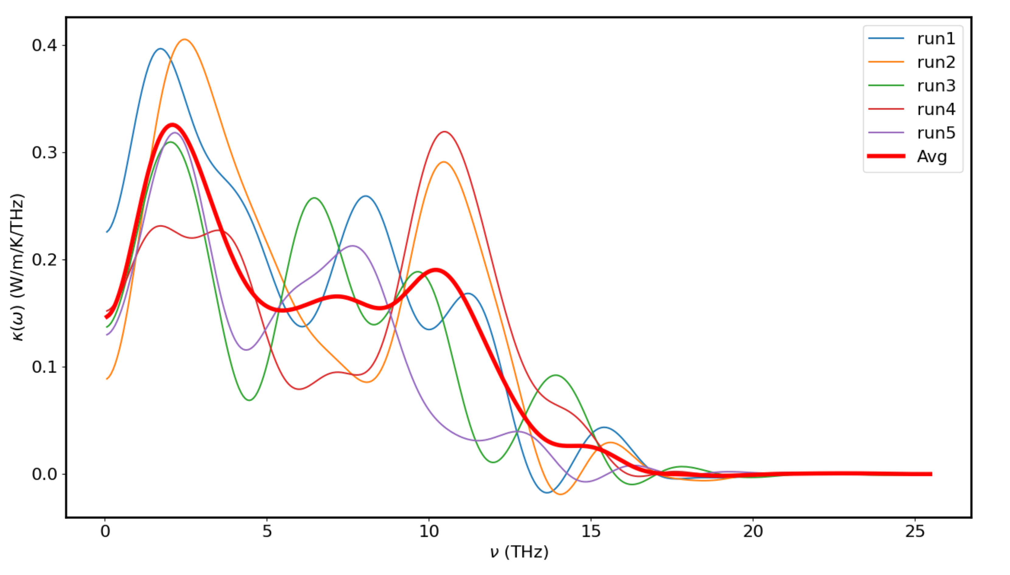
Ni_0.1_Zn_0.3 (400Ni - 1200Zn) - 300K – 0.00045

Slide 15
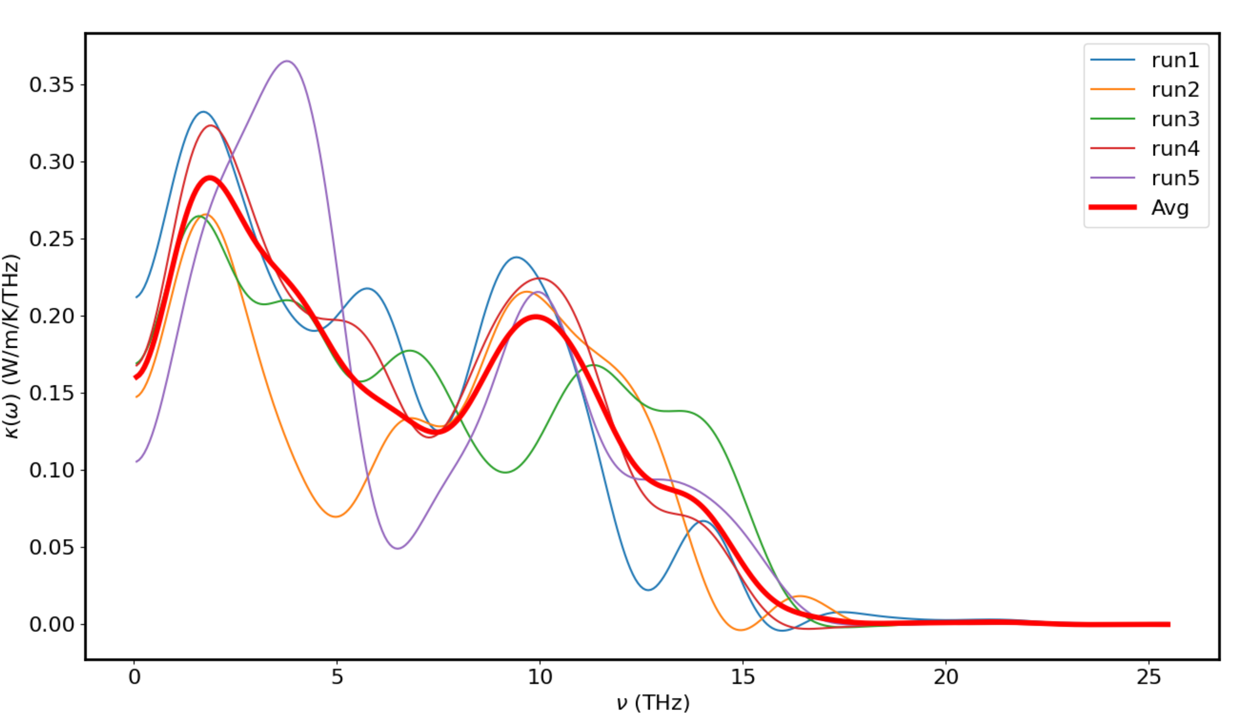
Ni_0.1_Zn_0.3 (400Ni - 1200Zn) - 300K – 0.0005

Slide 16
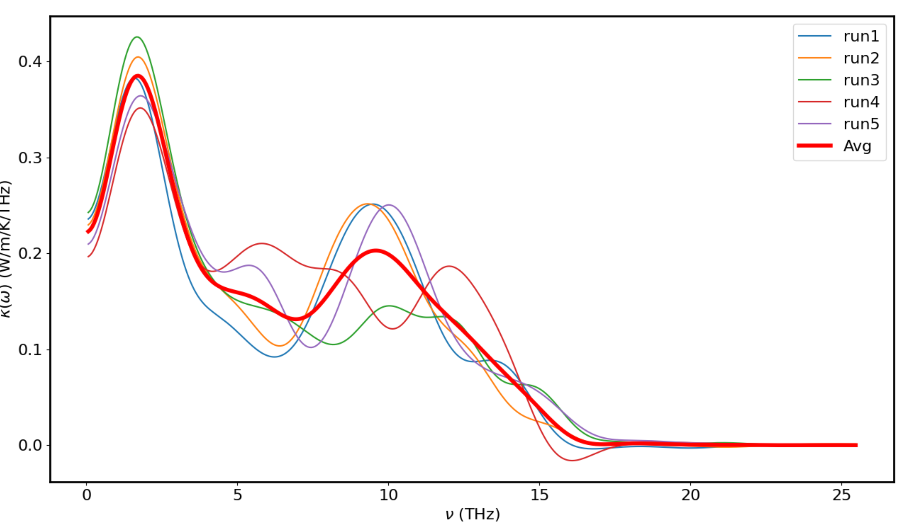
Ni_0.3_Zn_0.1 – Original – 300K – 0.00018

Slide 17
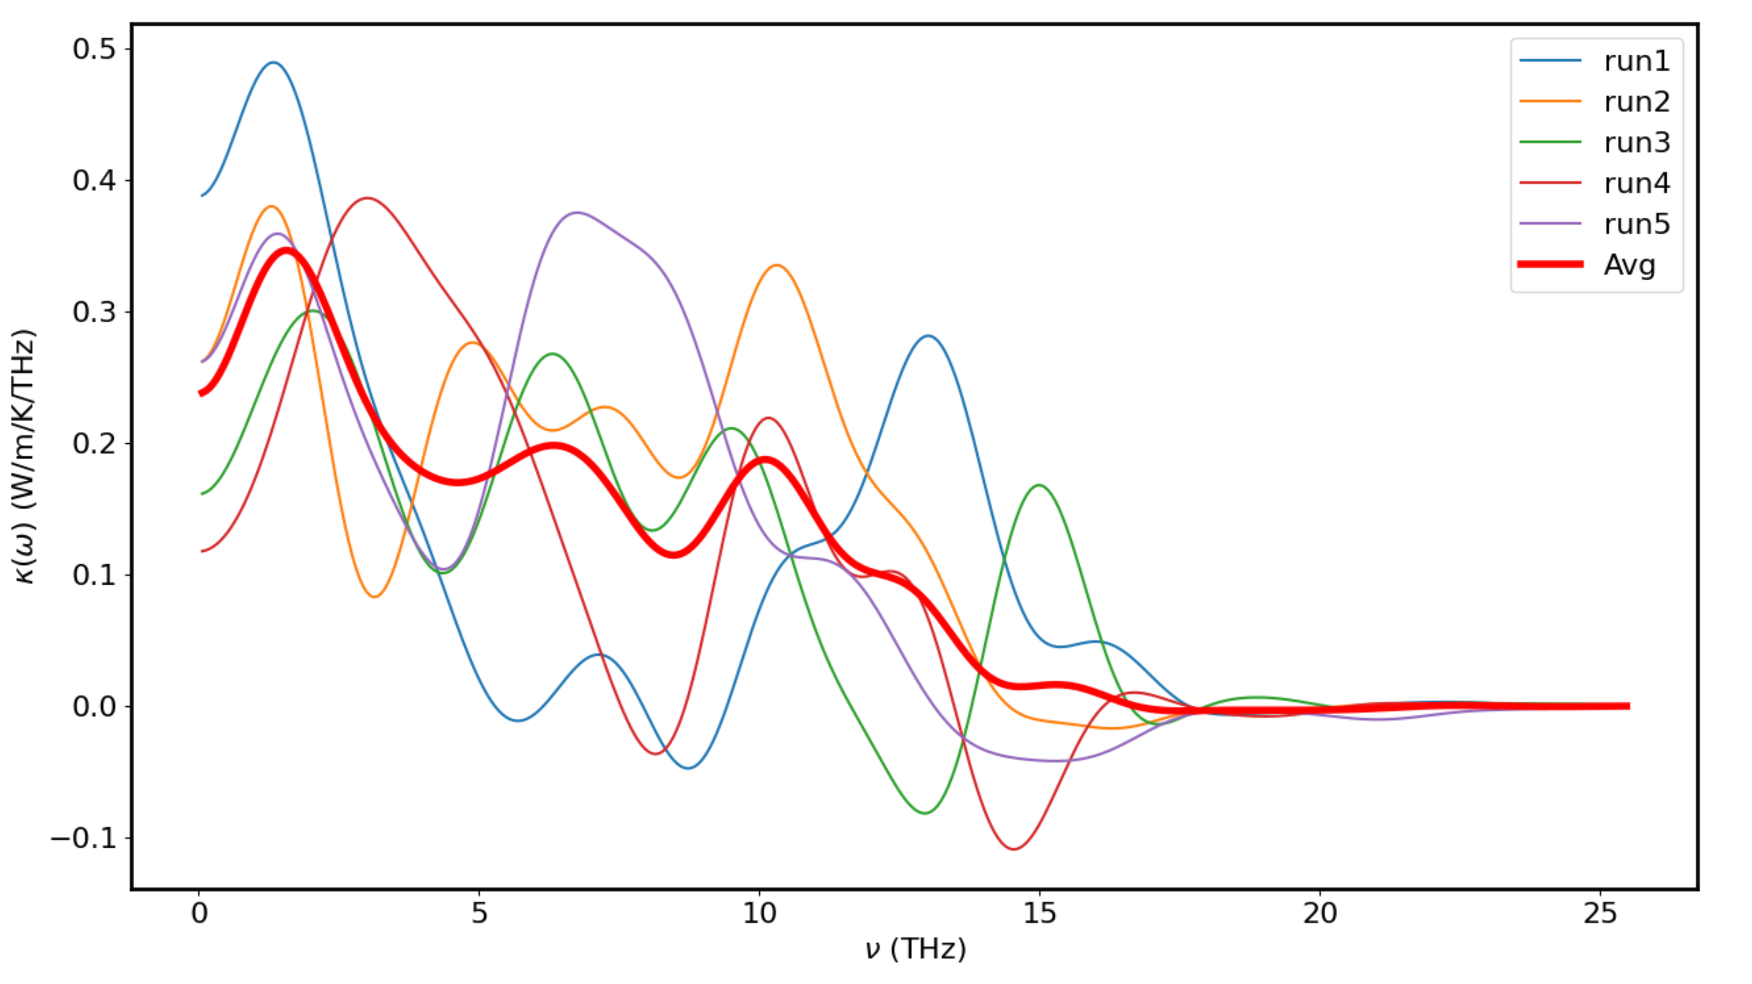
Ni_0.3_Zn_0.1 (1200Ni - 400Zn) - 300K – 0.00024

Slide 18
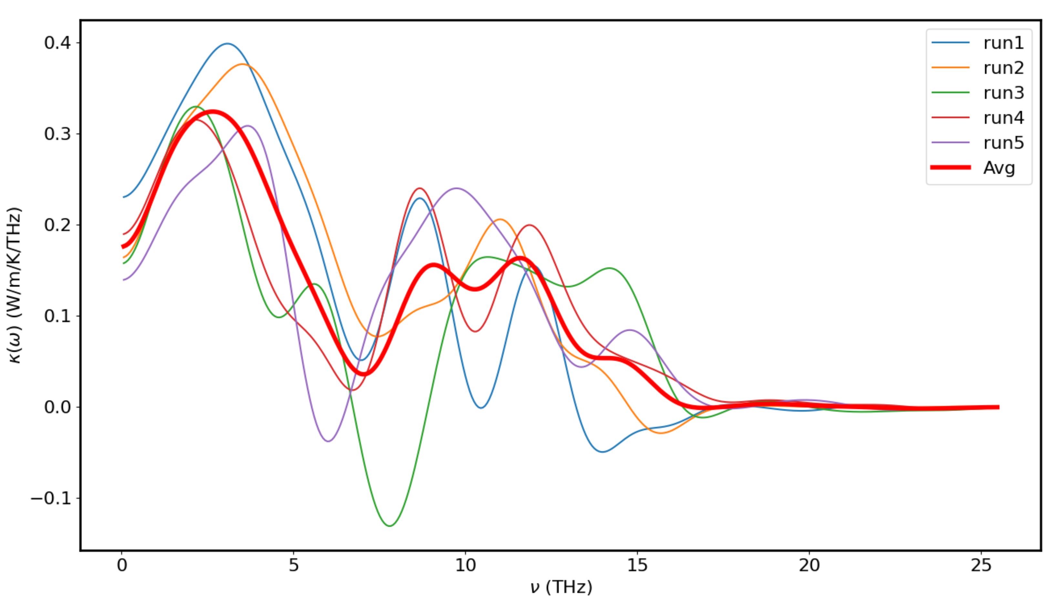
Ni_0.3_Zn_0.1 (1200Ni - 400Zn) - 300K – 0.0003

Slide 19
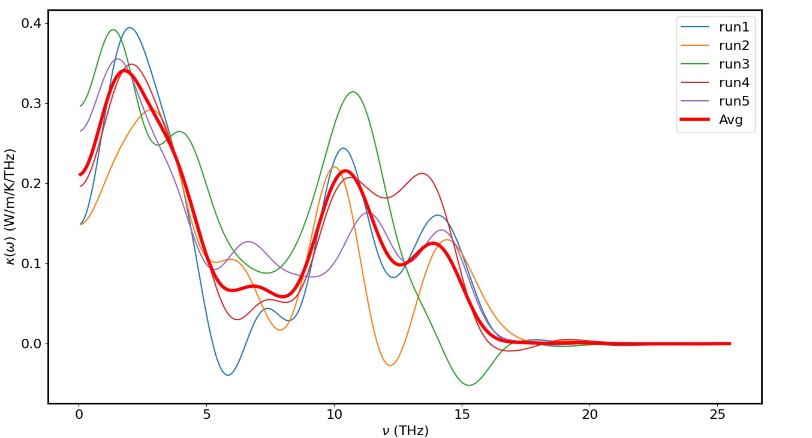
Ni_0.3_Zn_0.1 (1200Ni - 400Zn) - 300K – 0.00035

Slide 20
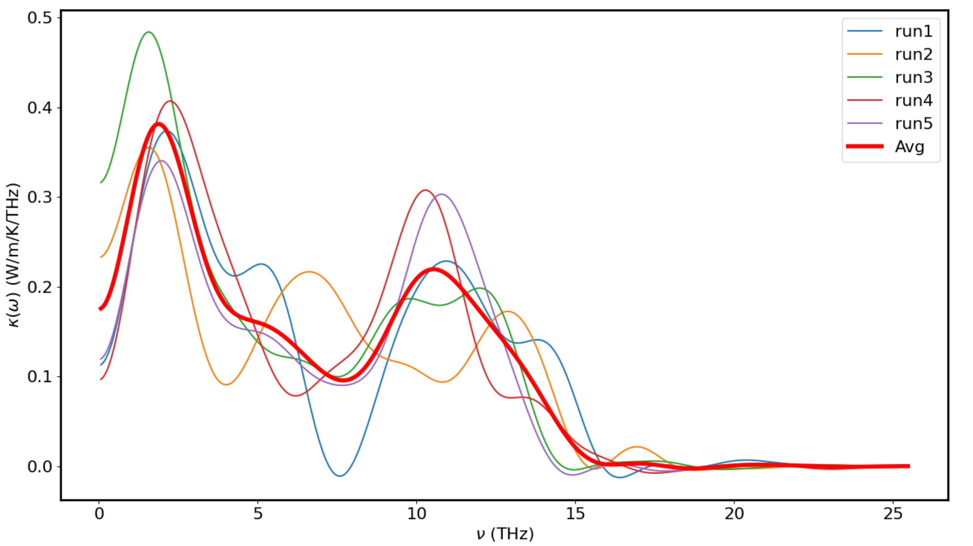
Ni_0.3_Zn_0.1 (1200Ni - 400Zn) - 300K – 0.0004

Slide 21
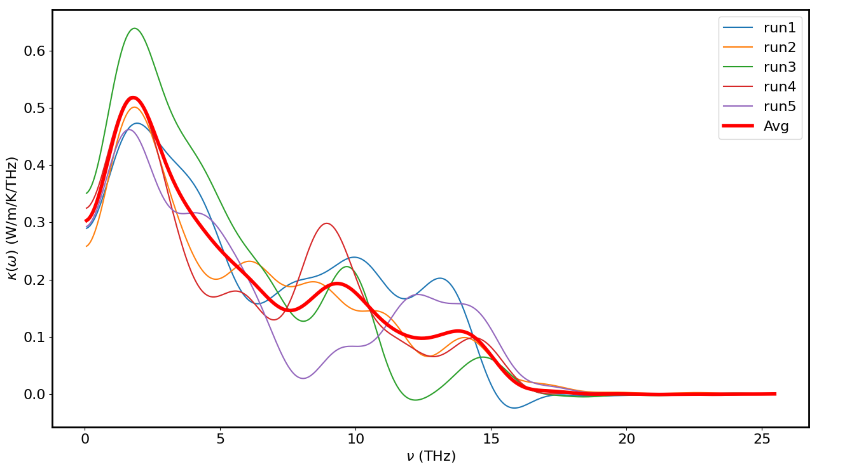
Ni_0.3_Zn_0.1 (1200Ni - 400Zn) - 300K – 0.00045

Slide 22
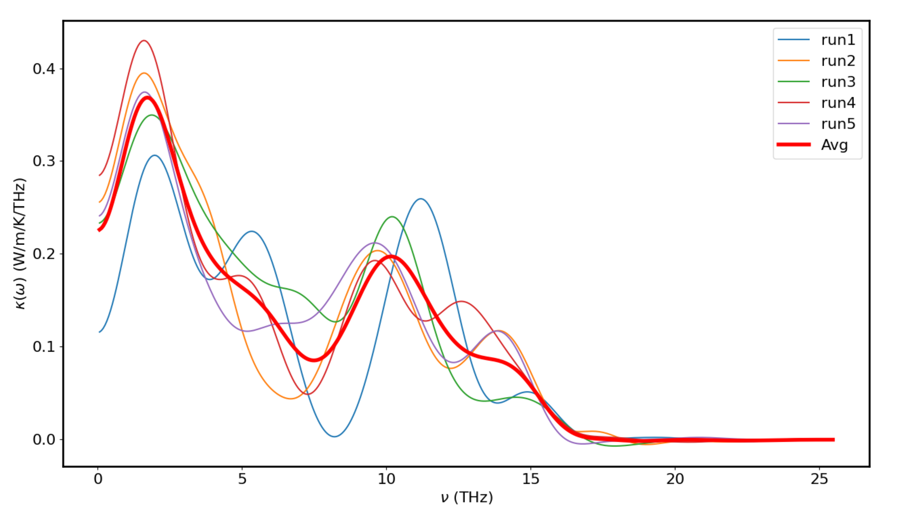
Ni_0.3_Zn_0.1 (1200Ni - 400Zn) - 300K – 0.0005

Slide 23
Ni_0.3_Zn_0.1 (1200Ni - 400Zn) - 300K – 0.0004 – 10M Runs

